Slide 1
Image Exif Data Analysis
-Piyush Chaudhary (pc1905)
-Rewa Jayant Kale (rjk422)
-Samet Taspinar (st89)

Slide 2
What is the problem?
Camera companies would like to know:
Popularity of their camera models, distribution and trends
Popularity of the camera models of their competitors
Improvements to be made in the models to increase popularity

Slide 3
What are analytical questions?
What is the distribution of commonly used camera models in Abu Dhabi over time, is there any trend?
What are the most popular settings for camera?
What are popular timings of the day for clicking pictures?
What is the popular dimension used for pictures?
What is the distribution of different huffman and quantization tables?

Slide 4
Which attributes in the data you can use to answer those questions?
Make - categorical
Model - categorical
Resolution - categorical
Brightness - quantitative
Exposure Time - quantitative
Flash - Categorical
DateTime - Ordinal

Slide 5
Attributes (Continued)
XResolution - Quantitative
Yresolution - Quantitative
Huffman table - Quantitative
Quantization table - Quantitative

Slide 6
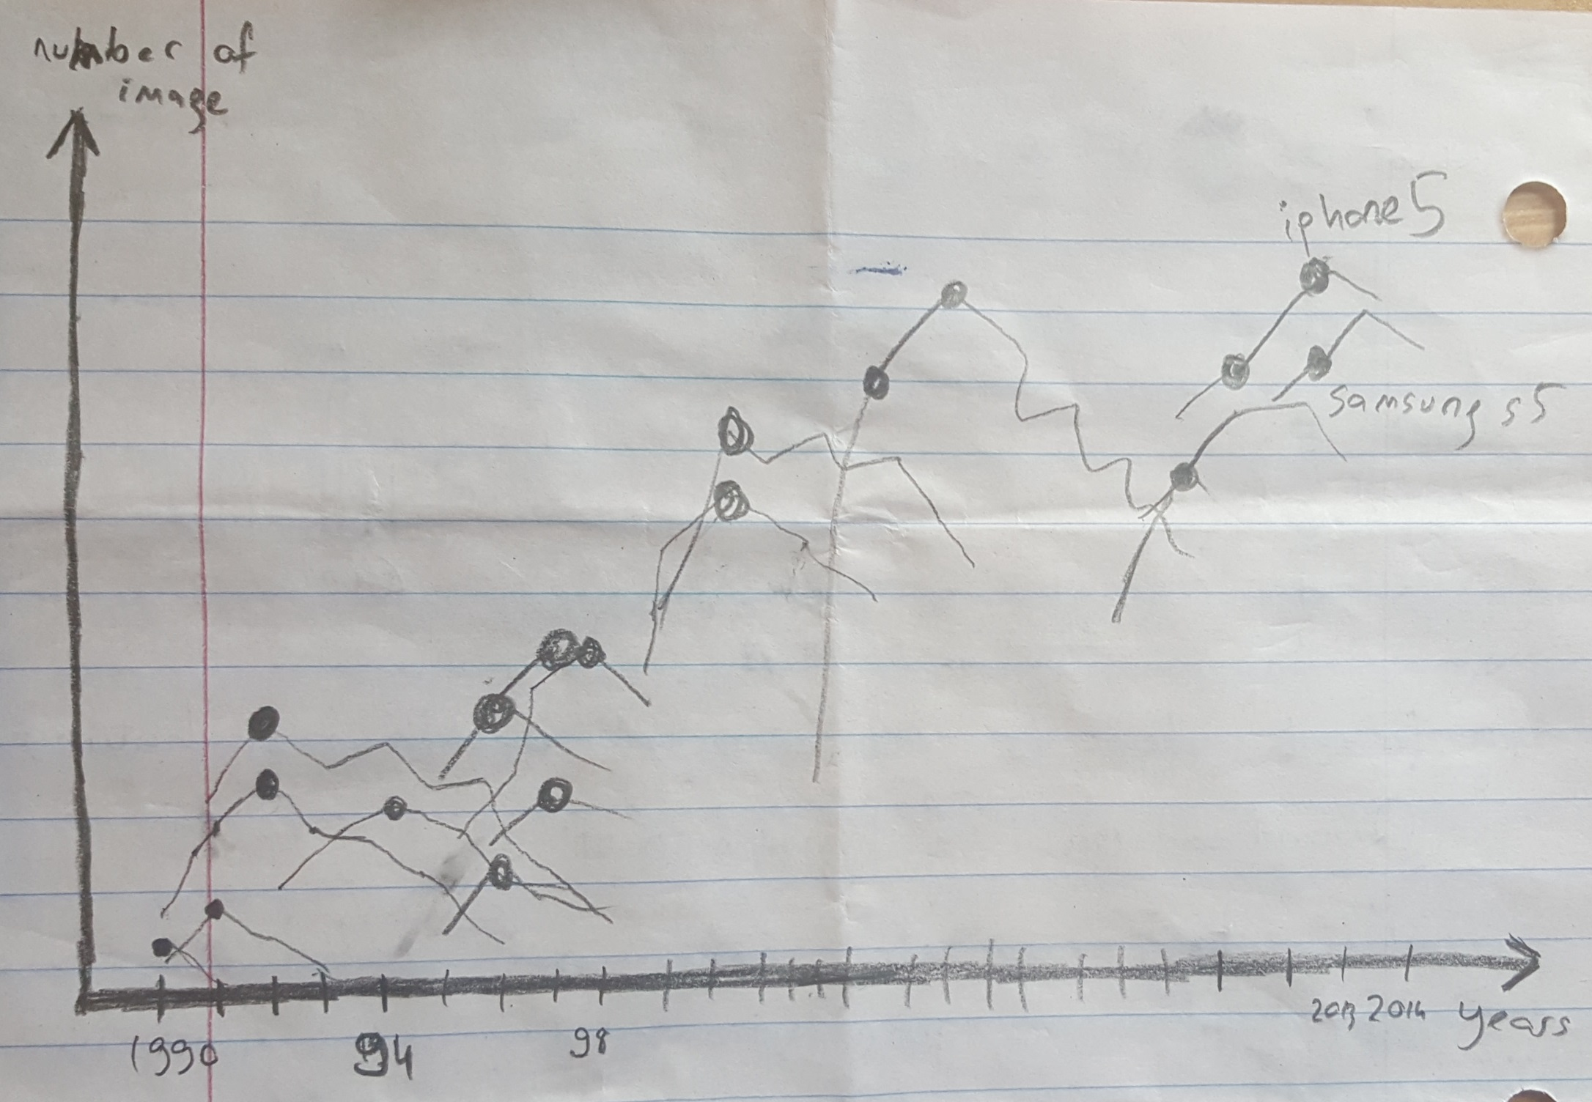
Samet’s Mockup
Title: The distribution of each individual model over the years.
item: Camera Models
mark: Dots
Attributes: Year,#images
trend over years, peak usage,
brand
Channels: x,y axes, lines,
position of dot on lines,
color of dot (correspondingly)

Slide 7
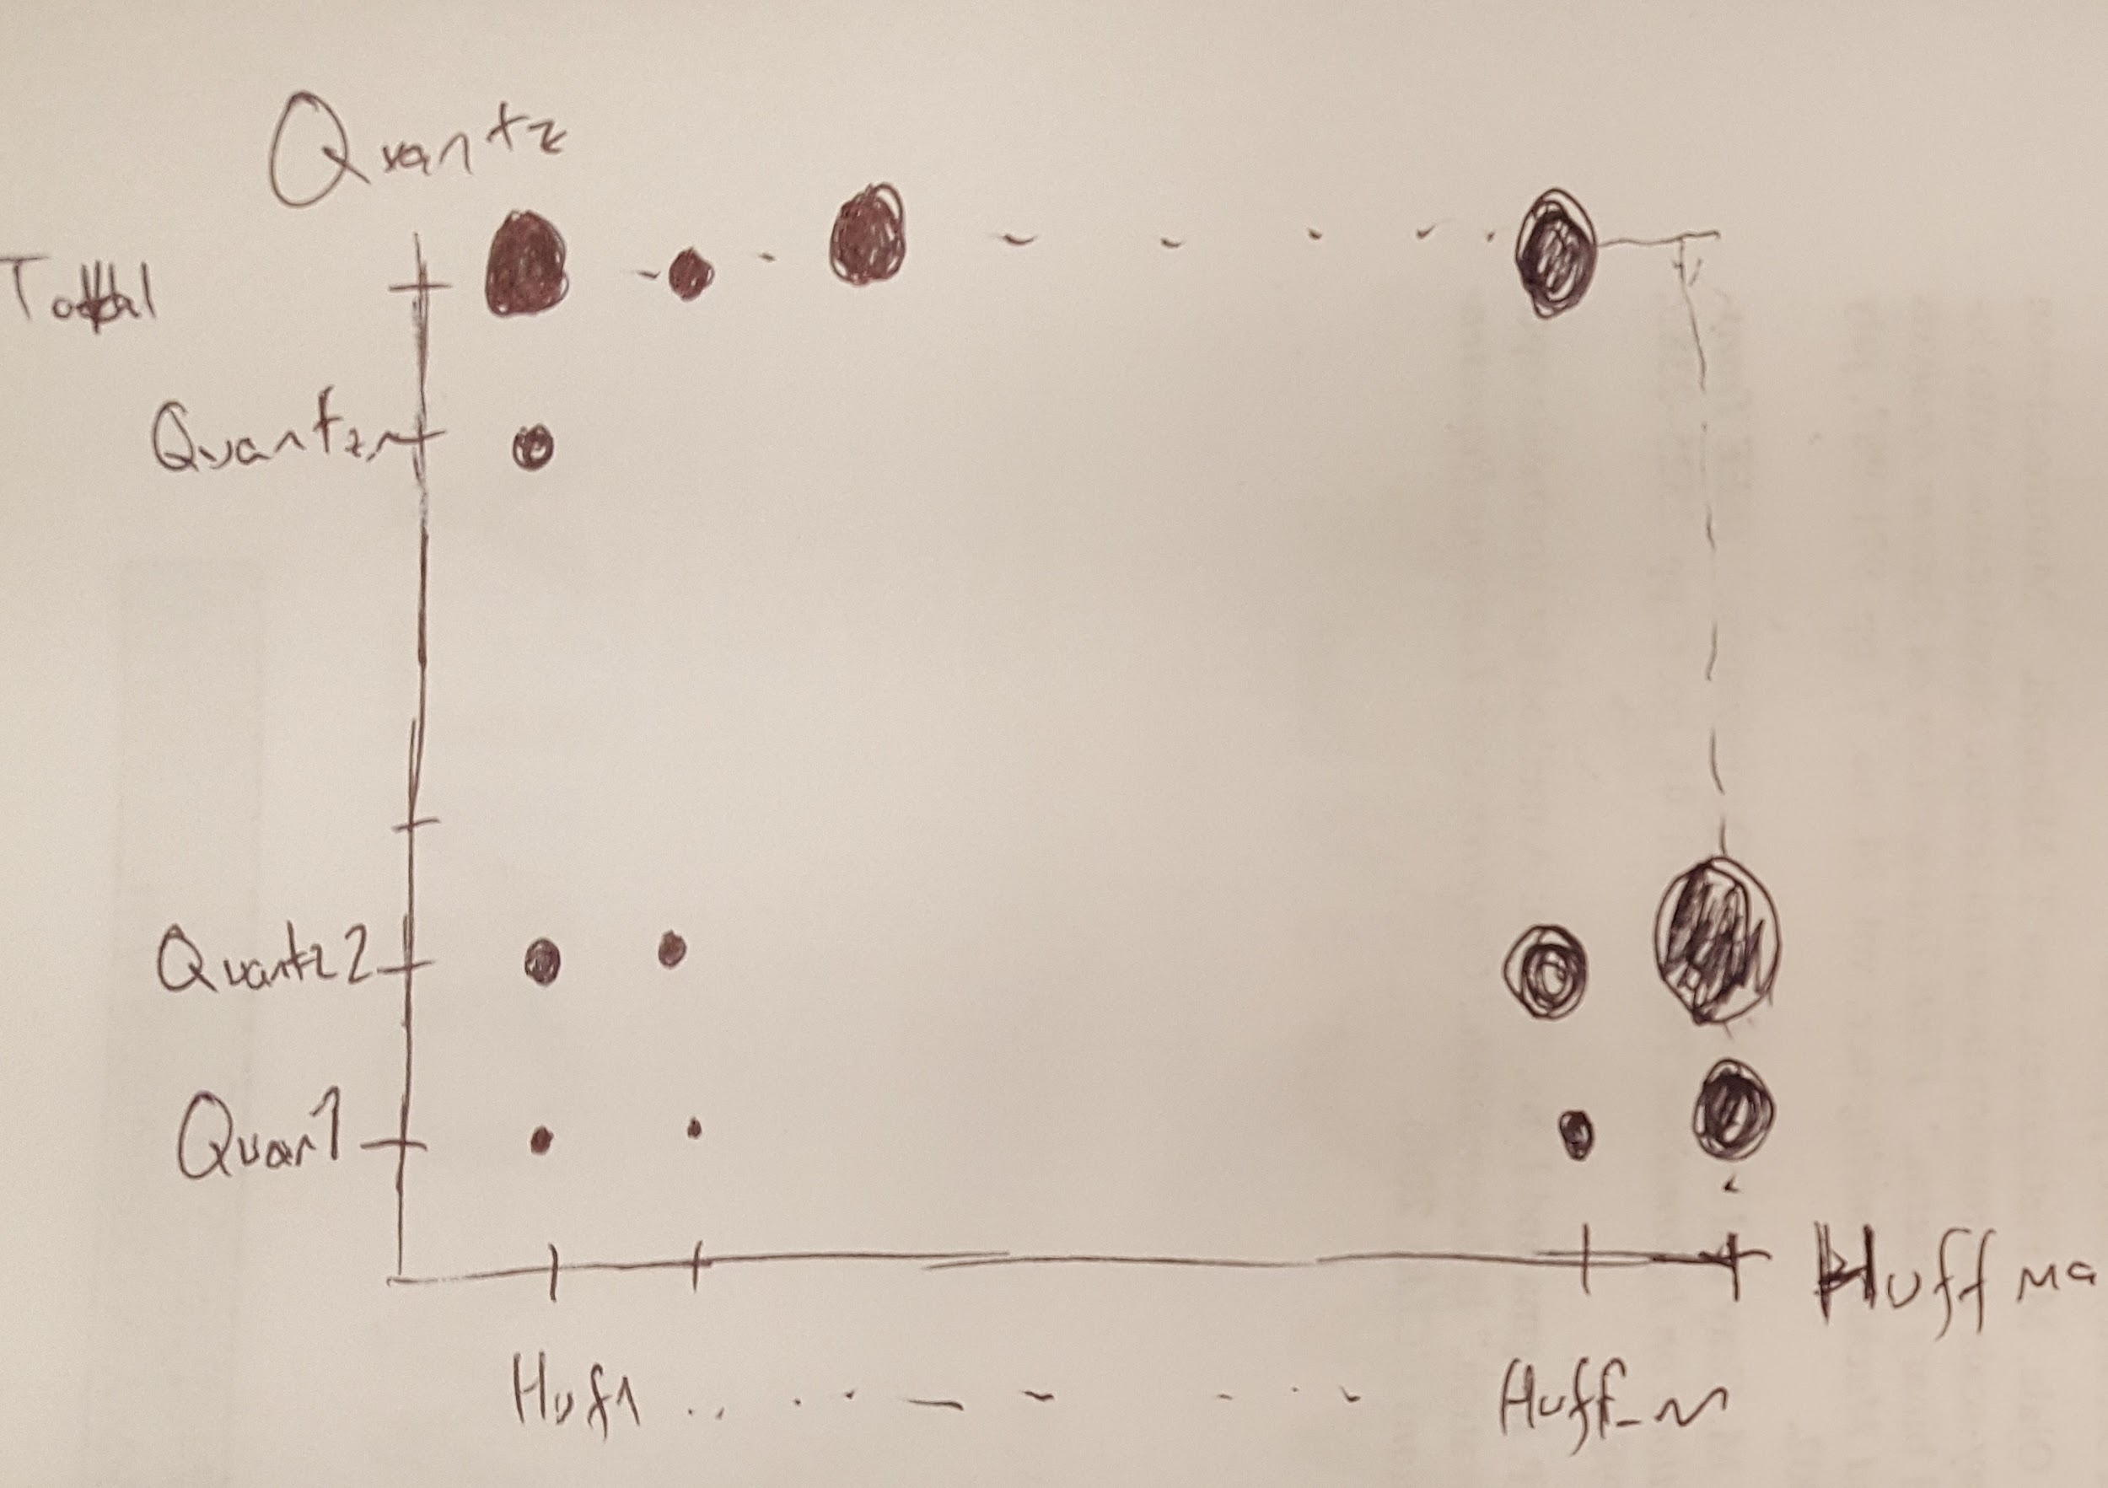
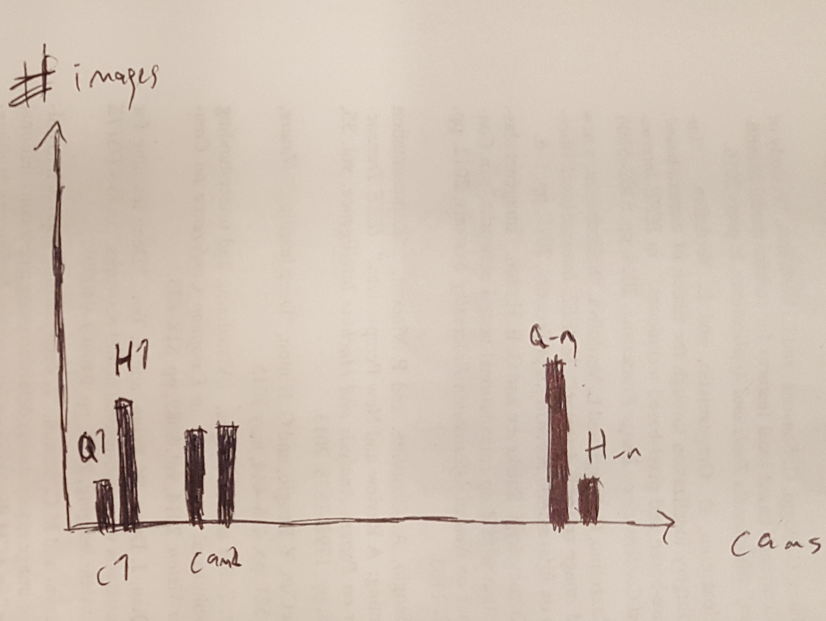
Samet’s Mockup
Quantization vs Huffman graph and Camera distribution of huffman and quantizations of a chosen dot
Item: set of images
Mark: dots
Attributes: Quantization table, Huffman table, #images,
Channels: y-axis, x-axis, area of dot

Slide 8
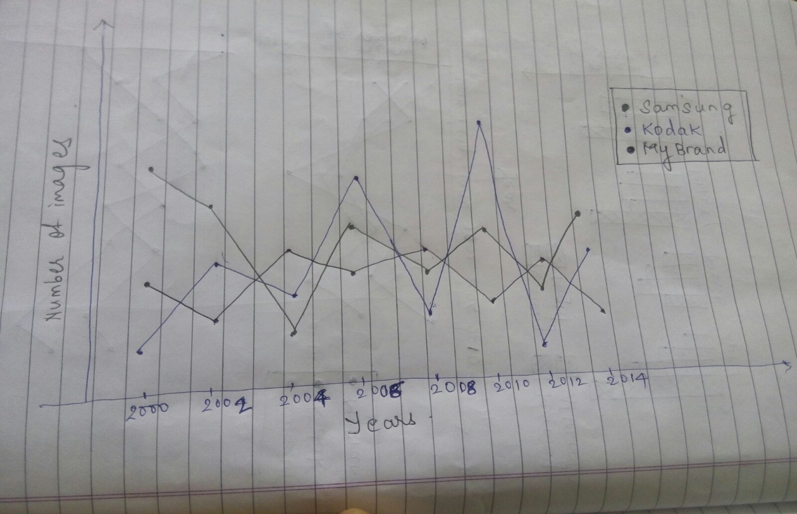
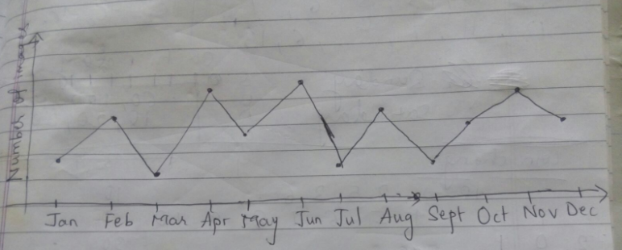
Rewa’s Mockup
Title: Number of images taken by camera for each model over the years
Line Graph
X-axis: year/month
Y-axis: number of images
Color: brand
Interaction through mouse click on dot

Slide 9
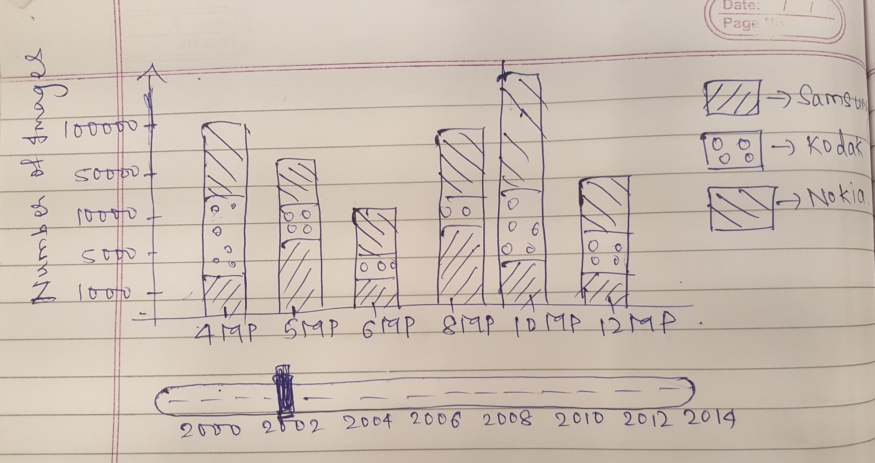
Piyush’s mockup.
Title: Most popular resolution setting among different models over time
X axis: Resolution of image
Y-axis: Number of images
Color : Brand or model of camera
Time line : Year

